Slide 1
The iOS and Android SDKs
TechTime for Sales
Date: July 25, 2013
Presented by: Robert Crooks

Slide 2
Welcome
“TechTime for Sales” is a sales training initiative with a goal to provide the BC sales organization with the technical information needed to help drive new, upgrade, renewal and add-on sales.
Please provide your inputs on this session and ideas for future topics of interest to Roberta Ingham
The slides and a recording of this session will be available within 1 week on Sales Central under Sales Training in a document called TechTime for Sales date topic

Slide 3
Agenda

Slide 4
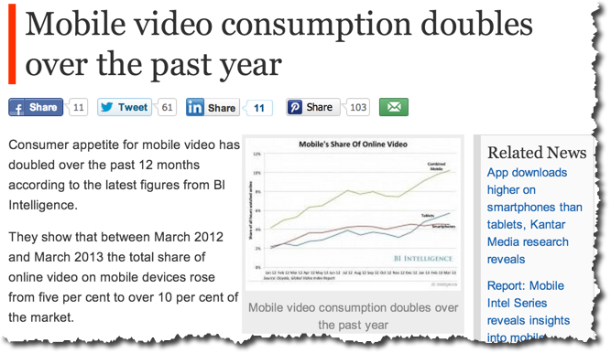
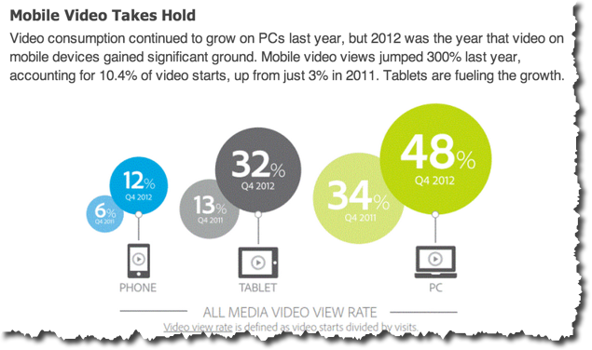
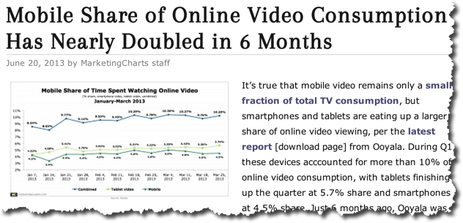
Mobile is rapidly moving toward dominance

Slide 5
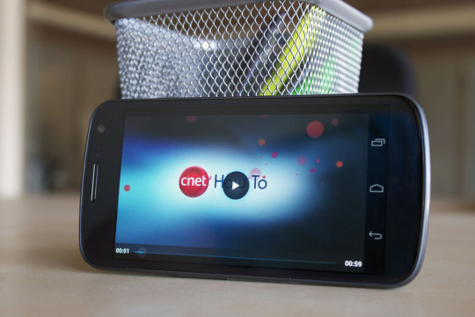

Getting your Video Content on Mobile isn’t easy
What keeps developers up at night?
  Fragmentation of adaptive streaming support
  Fragmented Pre-buffering support
  Monetizing with ads
  Analytics
  End user experience
Content providers don’t have it easy either…
  Content is king
  Smaller screens
  Diversity in screens
  Videos must look good on all connection types

Slide 6
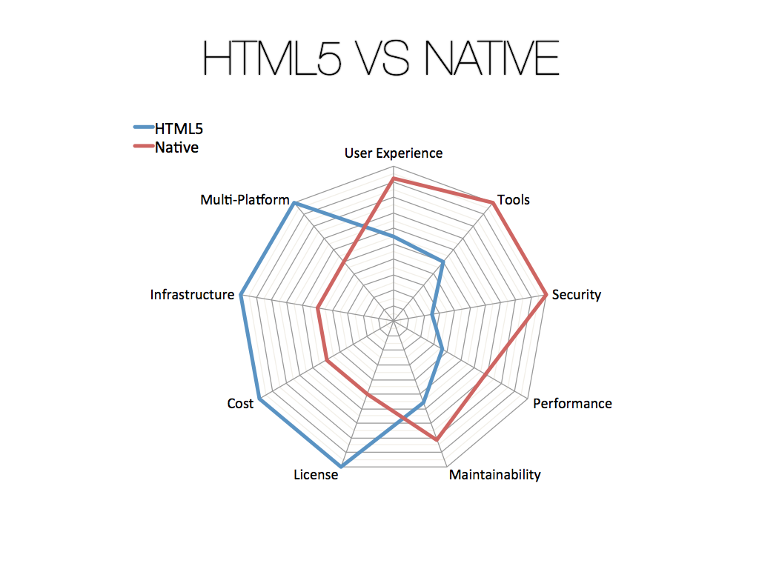
Native vs. HTML5 - Why Native?
Adaptive streaming
Memory Management
Tooling Support
DRM
HTML5 Video is incomplete..
  No DRM
  Spotty adaptive streaming
  No accessibility spec
  Spotty support for media formats
Source: http://www.icapps.com/wp-content/uploads/2012/06/04-HTML5-vs-Native.pdf

Slide 7
Introducing Video Cloud SDKs

Slide 8
Current State of the SDKs
Status
  SDKs and plugins are in limited commercial availability
  Includes plugins for advertising, analytics, and Widevine, HLS support
Significant update planned for September-October
  Pre-release program planned for August-September
  Tom Abbott manages the LA/Pre-release programs

Slide 9
What is available in iOS for Video
AV Foundation, Core Media
AVQueuePlayer, AVPlayer, AVAsset
Supports
  Online/Offline
  H.264, MPEG-4
  mov, mp4, m4v, 3gp
State Based
  Uses a mix of KVO, notifications, and blocks
Supports cool features
  Adaptive streaming
  Airplay
  Still image generation on the client
  Impressive ‘seek to’ functionality

Slide 10
What is Available in Android for Video
android.media.*
MediaPlayer, MediaController, VideoView
Supports
  Online/Offline
  H.263/4, MPEG-4, VP8
State-based
  Prepared
  Completed
  Error
  Initialized
  Started, Paused Stopped..
Supports cool features
  Wake Locks
  Wi-Fi Locks
  Timed Text
  Media Routing

Slide 11



Brightcove Android SDK Architecture
Brightcove
Video Cloud SDK
Built on top to enhance native media frameworks
Similar naming convention for entry points
Makes it simple to communicate with Video Cloud
Designed around ‘Components’ and ‘Events’
Handles the complexities associated with native platforms
AV Foundation
Brightcove
Video Cloud SDK
android.media

Slide 12

Components
Basic building blocks for integrating with the Brightcove SDK
BrightcoveVideoView is a component
Analytics is a component
Catalog is a component
Plug-ins are components

Slide 13






Plug-ins
Brightcove
Video Cloud
SDK
3rd Party SDK
Plug-in
A component that delegates communication between SDKs
Brightcove SDK and 3rd Party SDK are unaware of each other

Slide 14
Competitive Info
Ooyala – also has iOS and Android SDKs
  Appear to be less full-featured
  Development more complex
  Lack plug-in architecture – ad, DRM capability more tightly coupled, less flexible
Adobe PhoneGap
  Mobile web solution wrapped in native app code, similar to App Cloud
  We’ve been there, done that – our customers told us this solution isn’t robust enough

